Slide 1
Northeastern University DAMG6210 Data Management and Database Design Group Name: DATA INSIGHTS TOPIC: EVENT MANAGEMENT SYSTEM

Slide 2
Contributions
DISHA PATIL - 002768900 Table initialization, User creation, insertion packages, insert proc, function, exception handling, testing, presentation
ANUJ KUMAR- 002766036 Table initialization, User creation, insertion packages, insert proc, Role creation and User creation, trigger, testing, bug fix, reports.
SHUBHAM SABLE - 002747045
Table initialization, User creation, insertion packages, insert proc, testing ,presentation, documentation

Slide 3

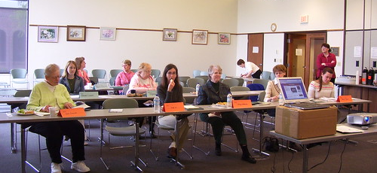
PROBLEM STATEMENT
An event booking system is a critical component of the entertainment industry, facilitating the management of events, ticket sales, and user interactions. This system enables event organizers, companies, and customers to plan, promote, and attend various events seamlessly. The current landscape of event management and booking is fragmented and lacks a centralized and user-friendly platform for all stakeholders involved. Organizers, companies, and customers face several challenges that need to be addressed by the proposed Event Booking System. With multiple users trying to book tickets simultaneously, ensuring data consistency and preventing issues like overbooking or double bookings is a challenge.
This Photo by Unknown author is licensed under CC BY-SA-NC.

Slide 4
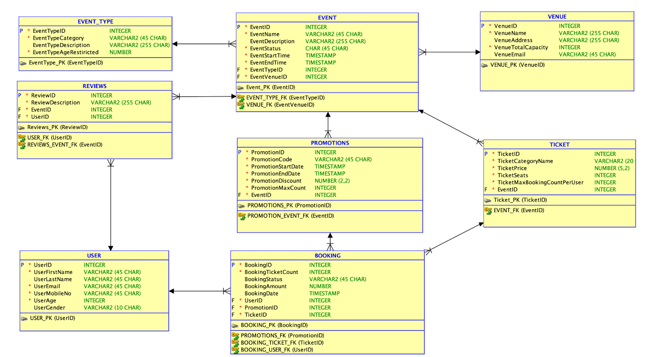
ER DIAGRAM

Slide 5

PURPOSE
The purpose of the system is to provide a comprehensive and user-friendly platform for event management. By implementing the mentioned business rules, the system aims to achieve the following:
User-Friendly Registration:
Controlled Booking Process:
Event Integrity:
Efficient Seat Management:
Effective Promotion Code Usage:
Cancellation Flexibility:
Seat Availability Assurance:

Slide 6

Purpose and solution

Slide 7
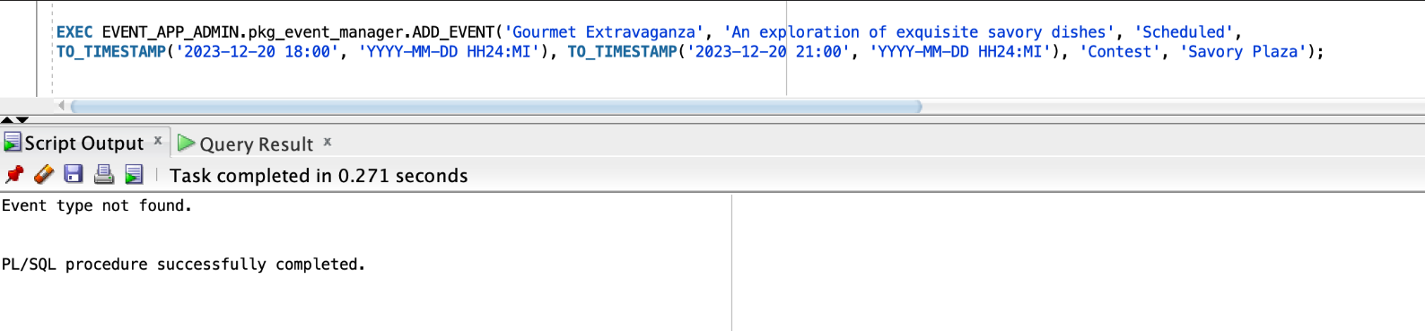
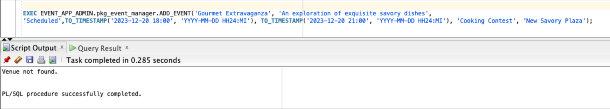
Event Type and Venue Association:
Business Rule: Events can be associated only with available event types and venues listed within the system.
Explanation: Ensures data integrity and prevents errors by restricting associations to predefined event types and venues.
Purpose (Data Integrity): This rule ensures that events are consistently associated with valid event types and venues, maintaining the integrity of the system's data. It prevents inconsistencies and enhances the reliability of event information.
Event Type not found
Venue not found

Slide 8
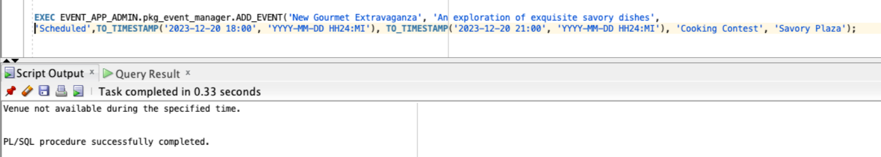
Venue Availability:
Business Rule: Ensure that a venue is available for the event's specified date and time.
Explanation: Validates the availability of the chosen venue, preventing scheduling conflicts.
Purpose (Avoiding Conflicts): By checking venue availability, the system avoids conflicts and ensures that events are scheduled at appropriate venues, enhancing the overall planning process.
If two events are trying to register at same time
Venue not available during the specific time

Slide 9
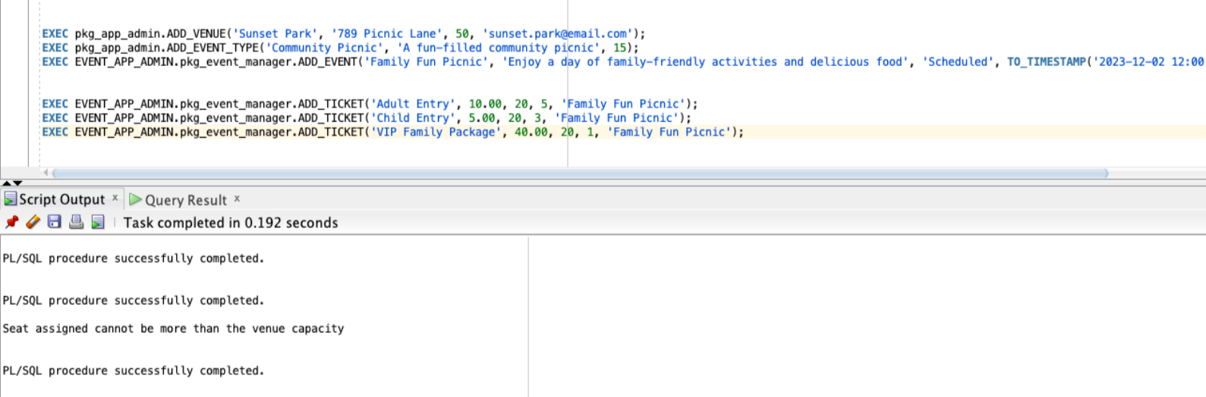
Checking Venue Capacity:
Business Rule: Check the venue's capacity and then add the desired number of tickets.
Explanation: Ensures that the number of tickets added does not exceed the capacity of the chosen venue.
Purpose (Capacity Management): This rule aids in managing venue capacity, preventing overbooking and ensuring a seamless event experience for attendees.

Slide 10
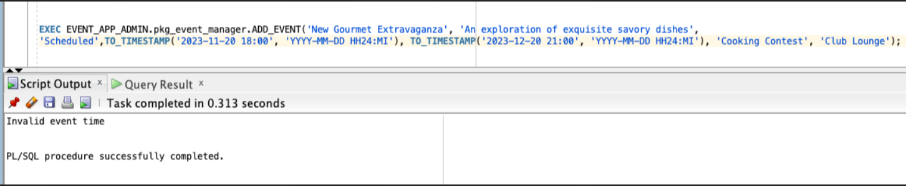
Scheduling Before Current Time:
Business Rule: Prevent scheduling an event before the current time.
Explanation: Ensures events are scheduled for future dates, avoiding confusion and ensuring accurate planning.
Purpose (Temporal Consistency): This rule maintains temporal consistency, preventing the scheduling of events in the past, which aligns with the natural progression of time and event planning.

Slide 11
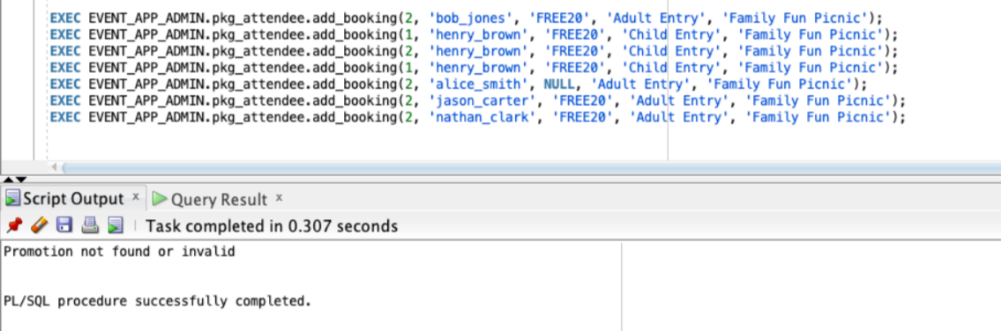
Promotion Limit:
Business Rule: Ensure the number of promotions does not exceed a specified limit.
Explanation: Manages the number of promotions to maintain a balanced promotional strategy.
Purpose (Promotion Strategy): By limiting the number of promotions, the system maintains a strategic approach to promotions, preventing overuse and ensuring their effectiveness.

Slide 12
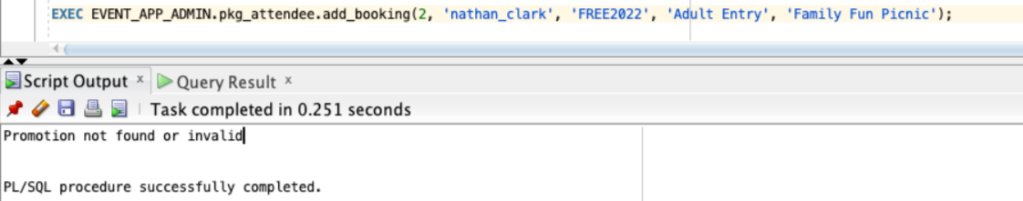
Applying Promotions to Different Events:
Business Rule: Prevent applying a promotion intended for one event to a different event.
Explanation: Maintains promotion-event consistency and prevents confusion.
Purpose (Consistency): This rule ensures that promotions are logically associated with the intended events, avoiding discrepancies and maintaining a clear promotional strategy.

Slide 13
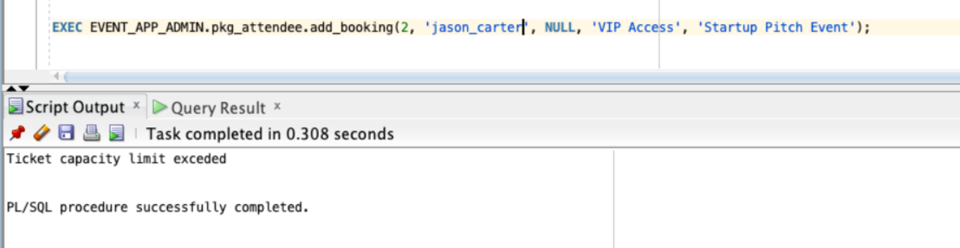
Ticket Capacity Limit:
Business Rule: Validate that the number of tickets added does not exceed the venue's capacity.
Explanation: Ensures adherence to venue constraints and avoids overbooking.
Purpose (Capacity Management): This rule contributes to effective venue management, preventing situations where the number of tickets exceeds the available capacity.

Slide 14
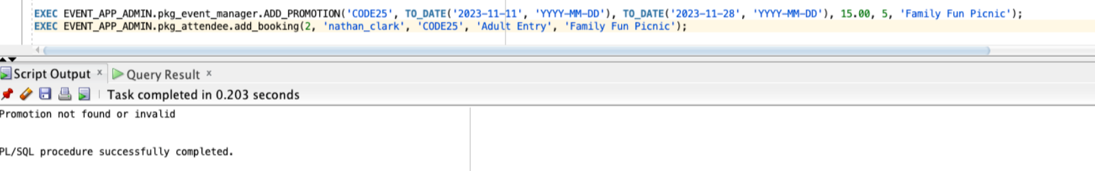
Invalid Promotion Time:
Business Rule: Start time must be before the end time for promotions.
Explanation: Enforces logical time constraints for promotions.
Purpose (Temporal Consistency): This rule ensures that promotions have valid timeframes, contributing to temporal consistency and logical scheduling.

Slide 15
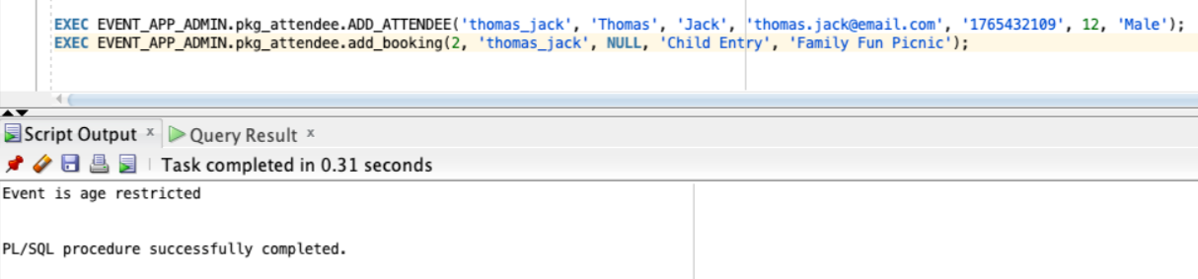
Age Restriction Check:
Business Rule: Verify that the attendee's age meets the specified event age restriction criteria.
Explanation: Ensures compliance with age restrictions for events, preventing ineligible attendees.
Purpose : (Audience Suitability): This rule contributes to audience suitability, aligning event attendance with age-appropriate criteria and preferences.

Slide 16
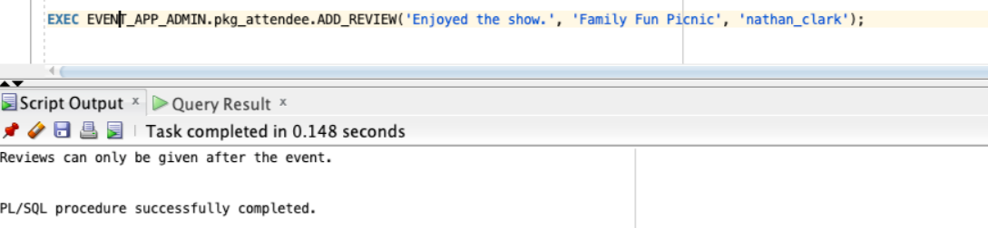
Review Creation Timing:
Business Rule: Reviews can be created only after the completion of the event.
Explanation: Restricts the creation of reviews to ensure they are based on actual event experiences.
Purpose (Event Authenticity): This rule enhances the authenticity of reviews by allowing them only after the event has concluded, providing accurate feedback based on attendees' actual experiences.

Slide 17
Views

Slide 18
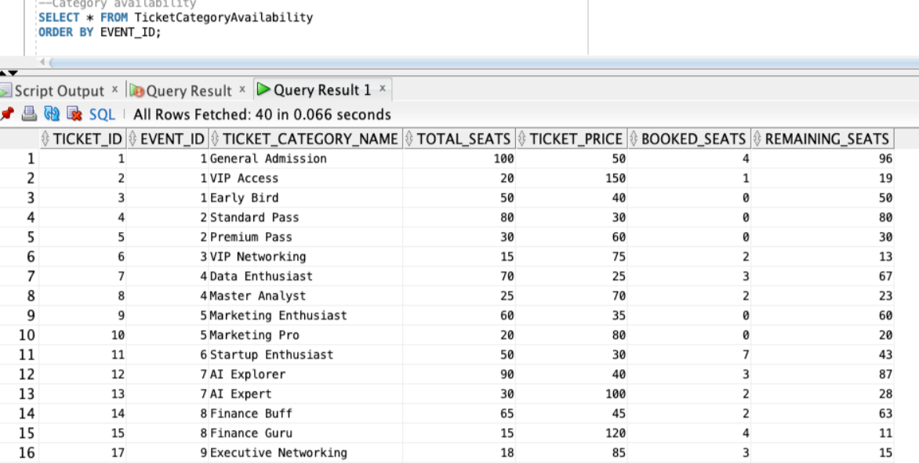
Category availability It includes information about the available ticket categories, their respective counts, and the associated event details. This view is particularly useful for organizers to make informed decisions about ticket sales, pricing adjustments, and ensuring a well-balanced distribution of ticket categories for each event SELECT * FROM TicketCategoryAvailability ORDER BY EVENT_ID;

Slide 19
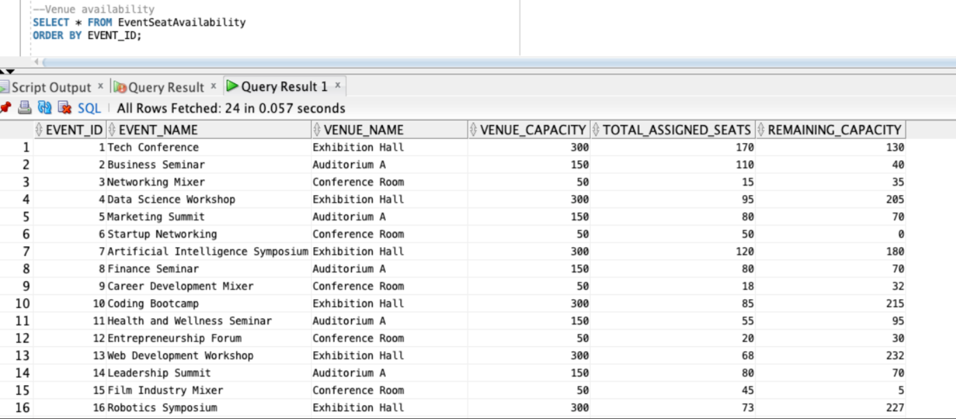
Seat availability The "EventSeatAvailability" view provides a detailed overview of seat availability for various events. SELECT * FROM EventSeatAvailability ORDER BY EVENT_ID;

Slide 20
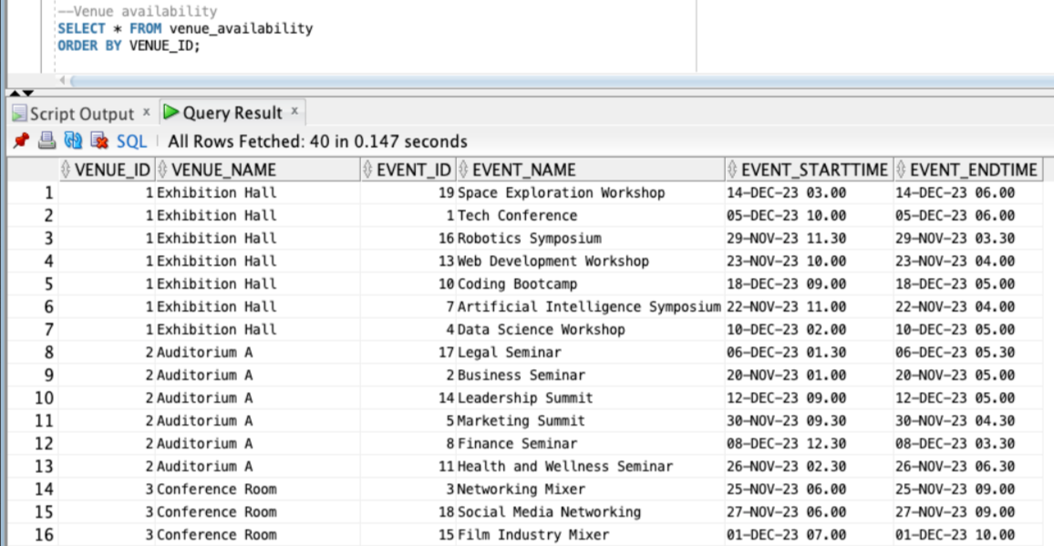
Venue availability The "venue_availability" view offers insights into the availability of different venues. It provides details such as venue ID, venue name,event name, start time, end time SELECT * FROM venue_availability ORDER BY VENUE_ID;

Slide 21
Functions

Slide 22
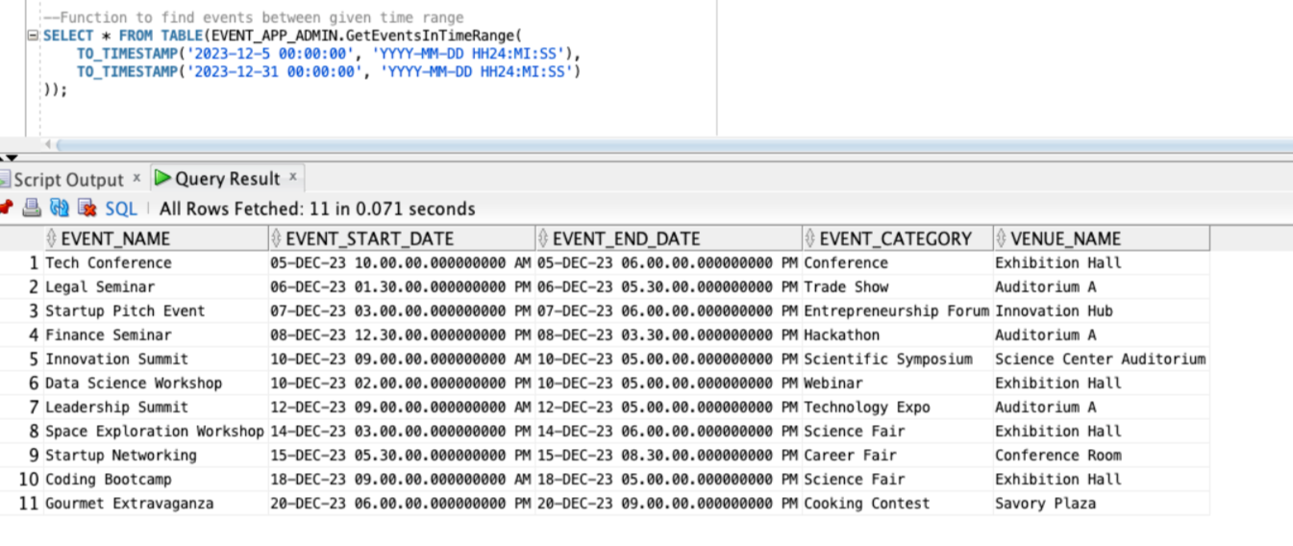
--Function to find events between given time range SELECT * FROM TABLE(EVENT_APP_ADMIN.GetEventsInTimeRange( TO_TIMESTAMP('2023-12-5 00:00:00', 'YYYY-MM-DD HH24:MI:SS'), TO_TIMESTAMP('2023-12-31 00:00:00', 'YYYY-MM-DD HH24:MI:SS') ));
The script utilizes a custom function named GetEventsInTimeRange to retrieve events that occurred within a specific time range.

Slide 23
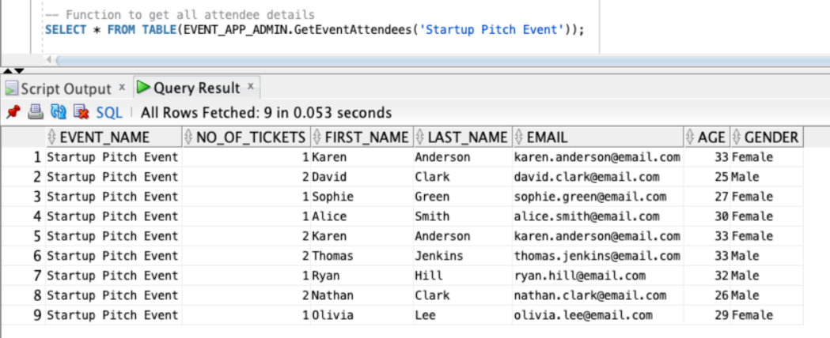
-- Function to get all attendee details SELECT * FROM TABLE(EVENT_APP_ADMIN.GetEventAttendees('Startup Pitch Event'));
The function GetEventAttendees is designed to fetch details of all attendees who have booked tickets for a particular event

Slide 24
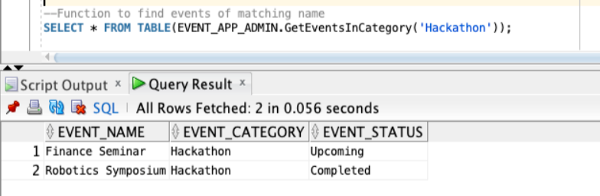
--Function to find events of matching name SELECT * FROM TABLE(EVENT_APP_ADMIN.GetEventsInCategory('Hackathon'));
The function GetEventsInCategory is designed to fetch events that belong to a specified category. In this case, the category is 'Hackathon'.

Slide 25

REPORTS

Slide 26
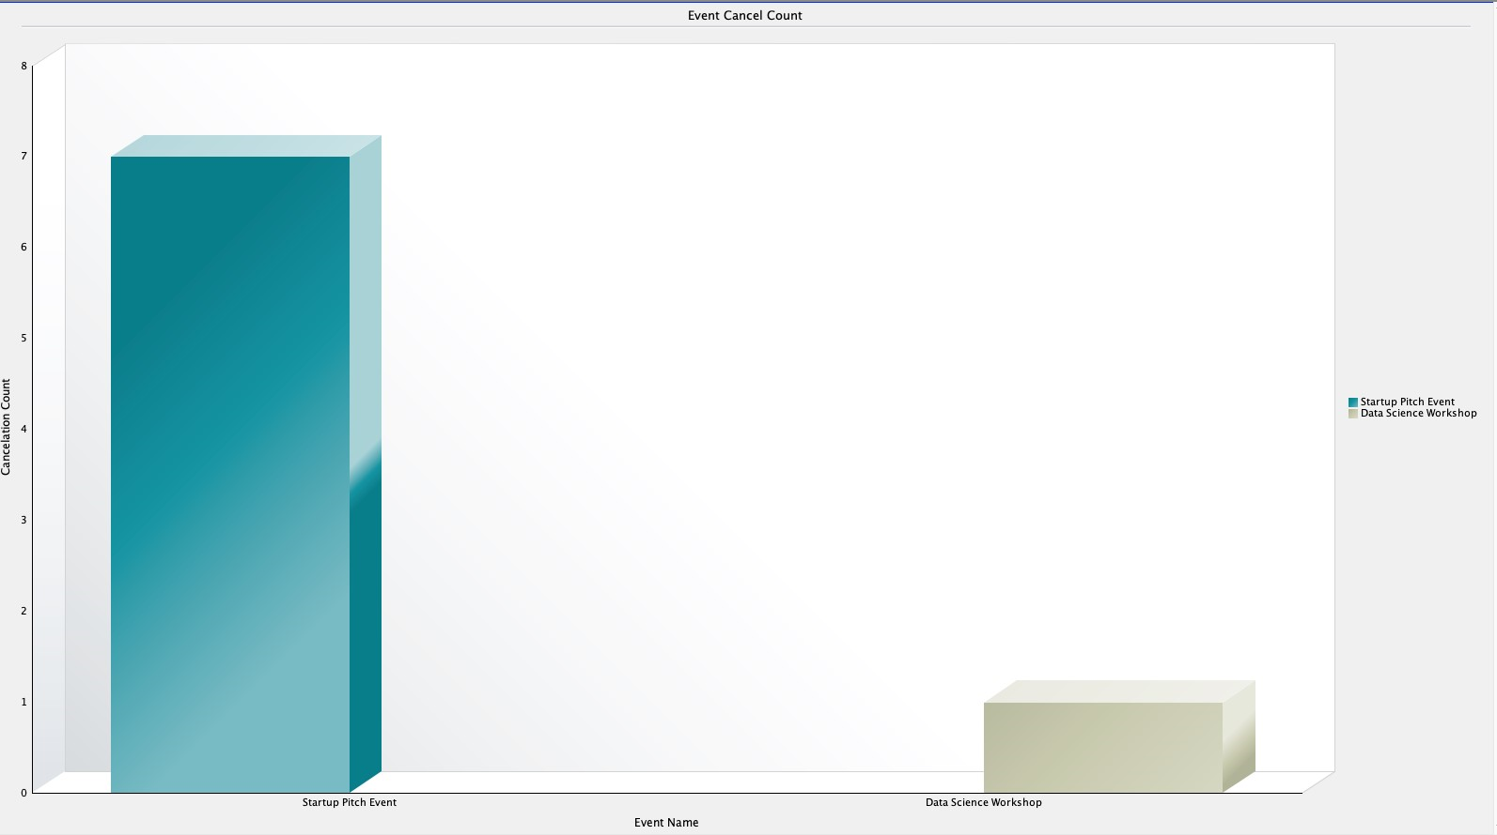
Event cancel The chart provides a clear overview of the cancellation count for each event, allowing organizers to analyze and understand the reasons behind event cancellations. Organizers can use this information to optimize various aspects such as scheduling, venue selection, or marketing strategies for specific events.

Slide 27
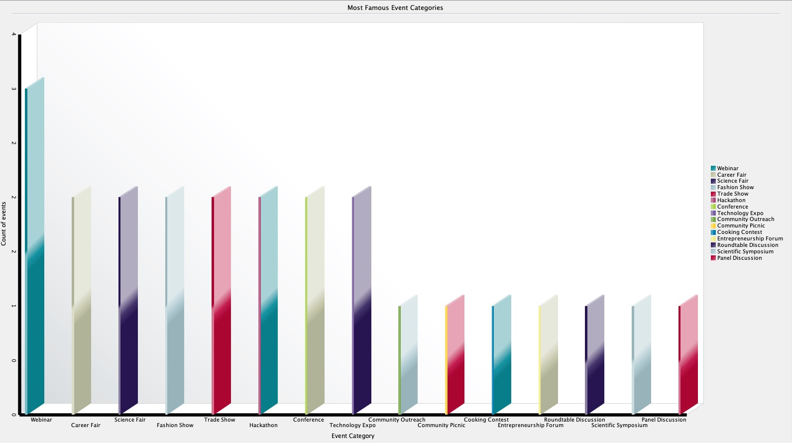
Famous Category The chart provides valuable insights into the popularity of different event categories based on the number of events within each category.This information is crucial for understanding attendee preferences and tailoring future event offerings to match popular categories.

Slide 28
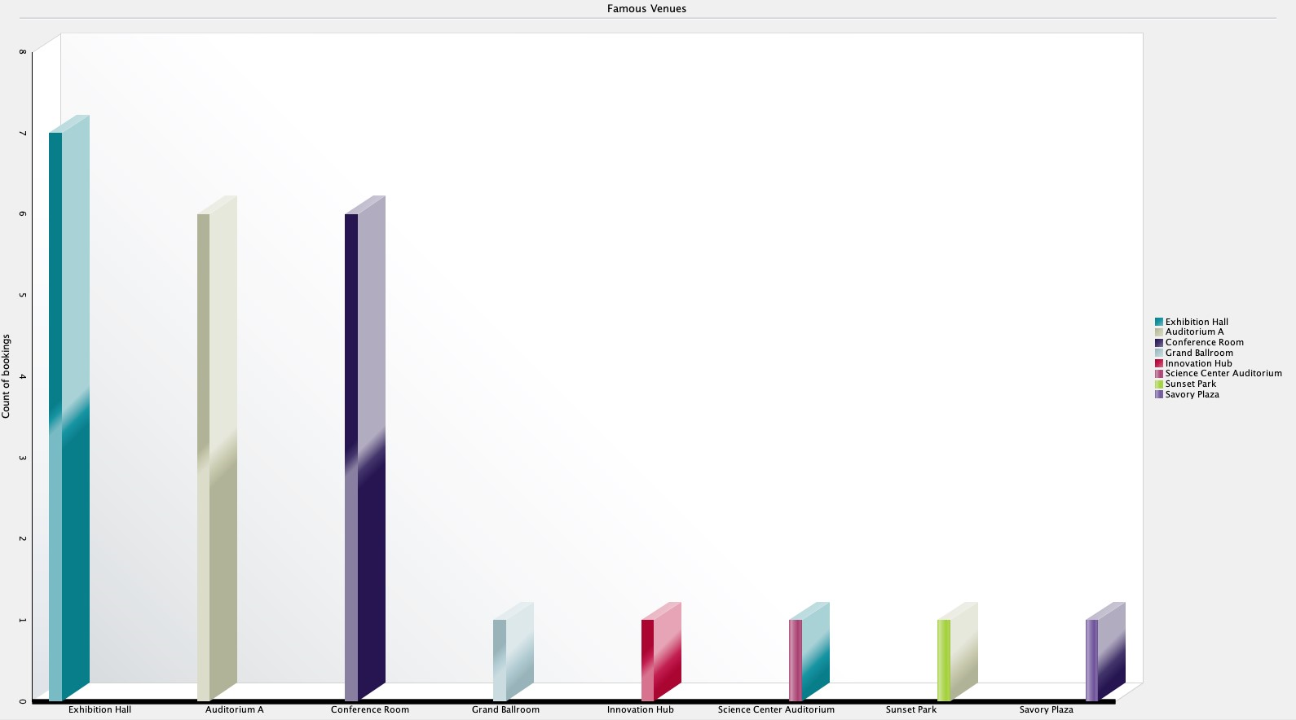
Famous Venues The chart provides insight into the popularity of different venues based on the number of bookings they have received. By showcasing the count of bookings for each venue, organizers can identify which venues are in high demand and preferred by attendees.

Slide 29
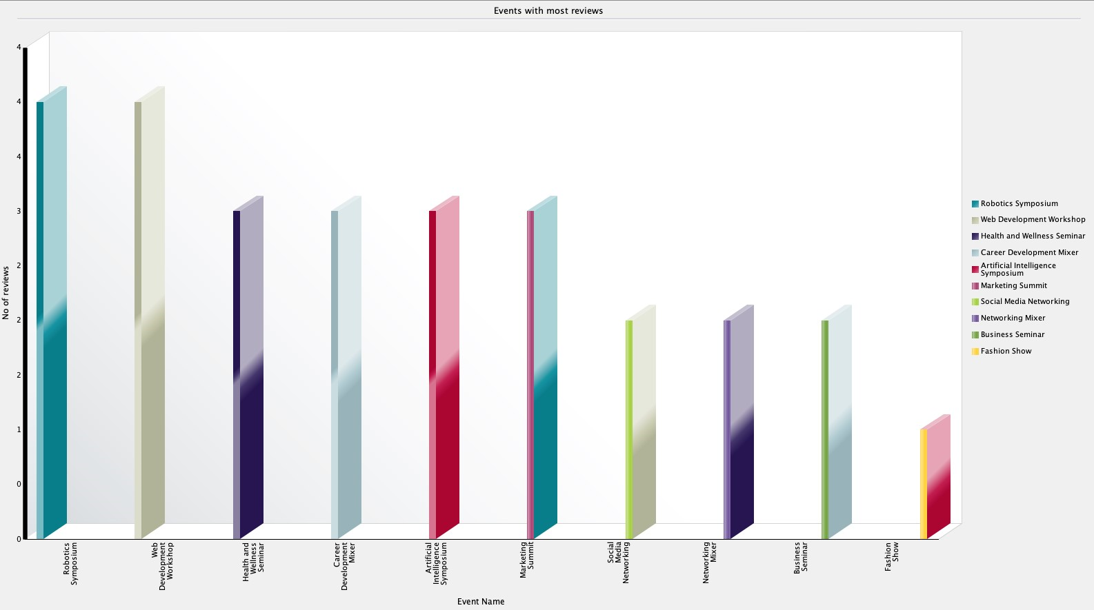
Most reviewed event The chart helps organizers identify events that have garnered the most attendee engagement and feedback. By showcasing the number of reviews for each event, organizers can gauge the level of interaction and satisfaction among attendees.

Slide 30
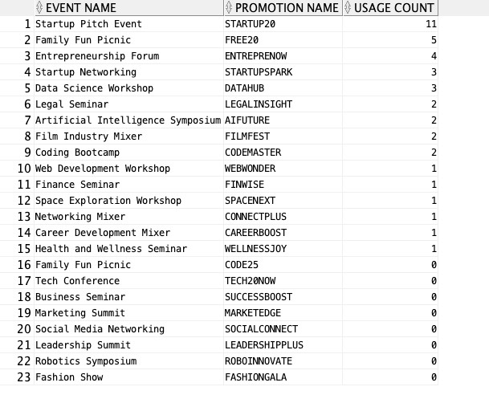
Promotion Usage for events By analyzing the promotion usage count alongside the event names, organizers can evaluate which promotions resonate most with attendees. This targeted approach enhances the impact of promotions, leading to increased attendance and overall event success.

Slide 31
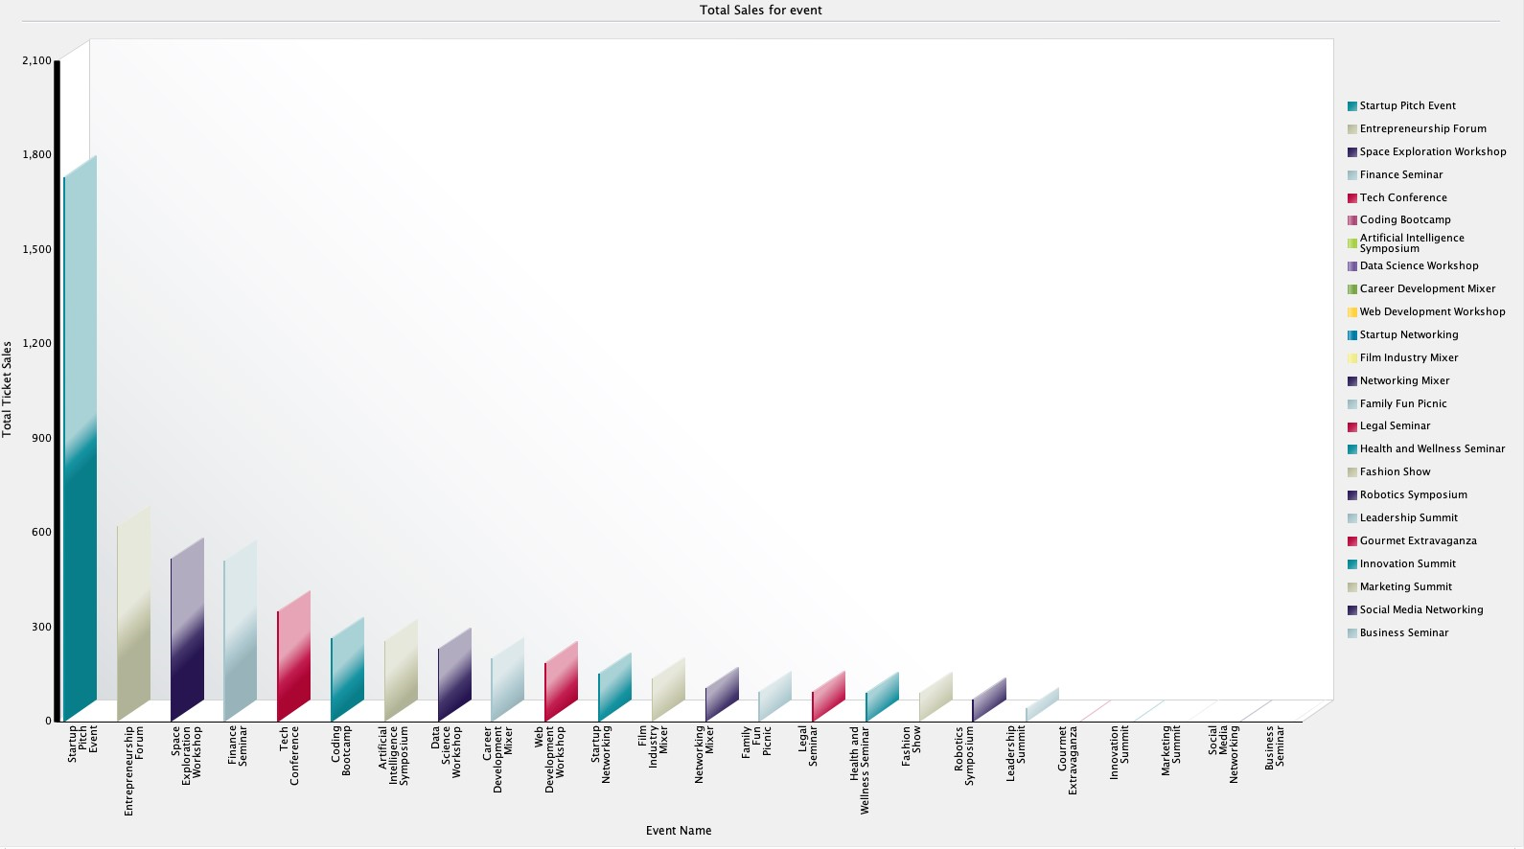
Sales for events The chart provides a comprehensive overview of the total ticket sales generated by each event. This information is crucial for assessing the financial performance of individual events . By analyzing which events attract higher ticket sales, organizers can refine their marketing strategies, allocate resources more effectively, and tailor future events to meet the preferences and interests of their audience.

Slide 32
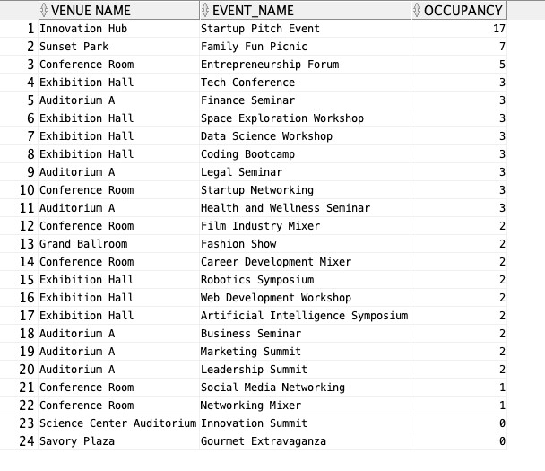
Venue occupancy Charts provide a graphical representation of venue occupancy, allowing event organizers to quickly assess and compare the utilization of different venues. This visual representation enhances clarity and aids in making informed decisions related to event planning and venue management.

